Slide 1
What is Design?

Slide 2
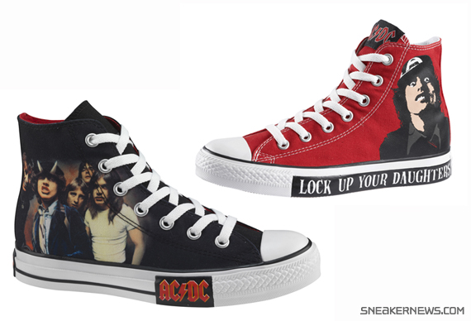
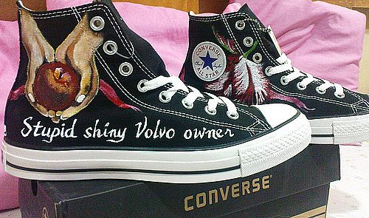
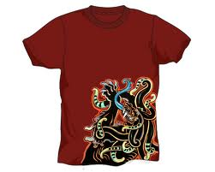
Aa definition?
Design is everywhere; in everything man made. Its what drew you to the last sneakers you bought and or the shirt you wore today.

Slide 3
Design can make buses able to carry bikes & make products easily recognizable .

Slide 4
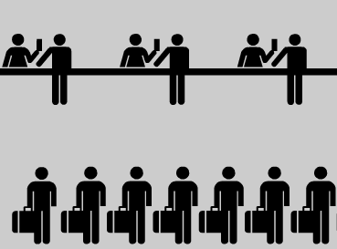
Design drives business culture &
causes environments from hospitals to airports to be easier to navigate.

Slide 5
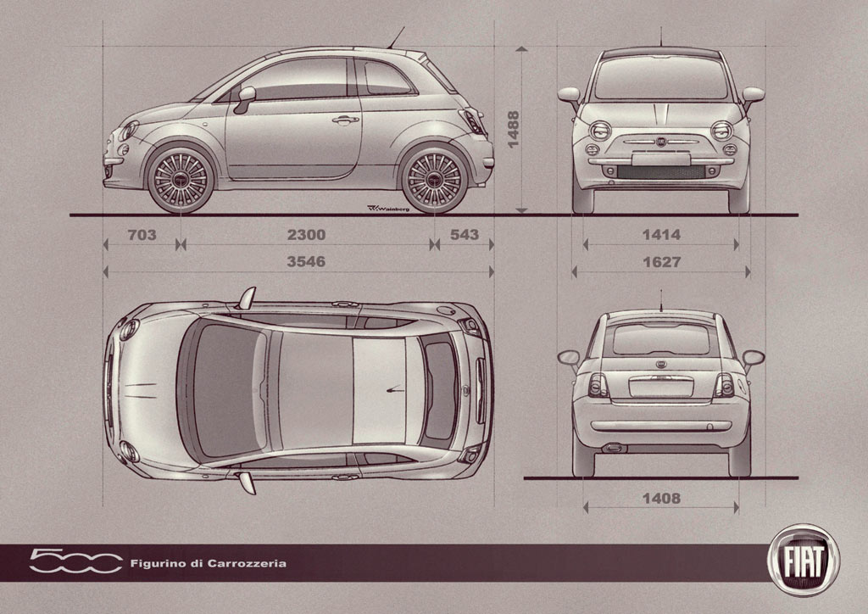
From a concept or idea (left) to real thing (above)…
“Design could be viewed as an activity that translates an idea into a blueprint for something useful, whether it's a car, a building, a graphic, a service or a process.” Design Council

Slide 6
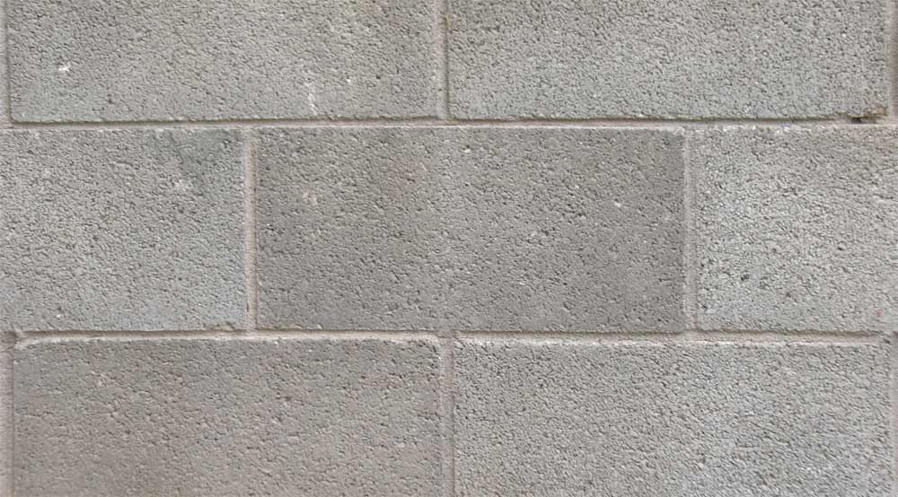
While design is a part of virtually all aspects of our daily life, good (or conscious) design isn’t.
Just look around. You are in a cinder block school. What were the driving ideas behind the design of this school? Budget? Beauty? A nice relaxing natural place to learn in?
See what I mean……
Mmm, friendly.

Slide 7
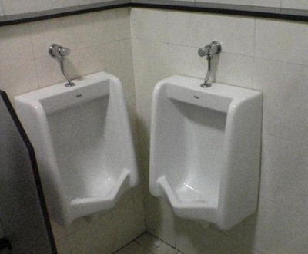
So DESIGN is everywhere, in everything. But GOOD design is not.

Slide 8
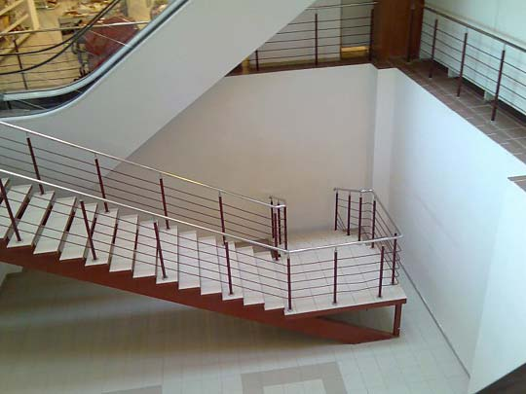

Slide 9
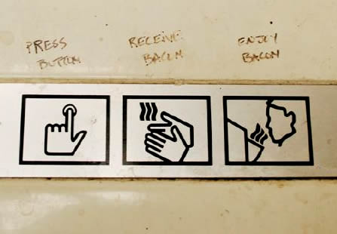

Slide 10
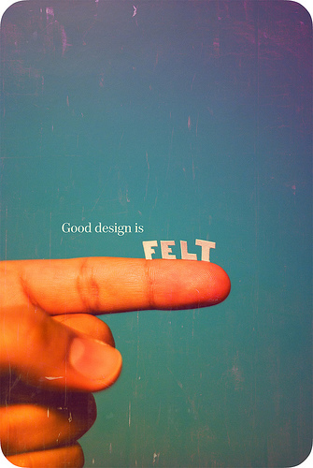
In terms of learning about design. We are going to start with the basics first.

Slide 11
Elements & Principles of Design
good design is all about this…

Slide 12
The Elements of Design:
These 7 ingredients are used to create a design:
1. line
2. shape
3. color
4. value
5. form
6. texture
7. space

Slide 13
line
(Think ‘directional mark made by a tool’)

Slide 14
Shape
(Think ‘outline’)

Slide 15
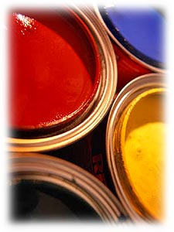
color
(Think ‘variety’ – can be bright or dull, light or dark, etc.)

Slide 16
value
(Think ‘degree of lightness or darkness’)

Slide 17
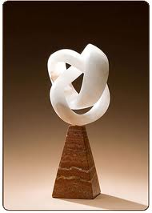
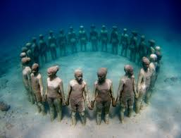
form
(Think ‘dimensional’)

Slide 18
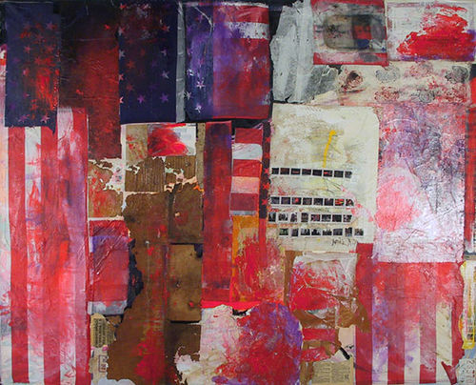
texture
(Think ‘the look/feel of the surface’)

Slide 19
space
(Think ‘distance in & between things’)

Slide 20
The Principles of Design
The principles are how you decide to put all the elements together.
You can make a zillion choices when doing this.

Slide 21
The Principles of Design:
1. balance
2. contrast
3. emphasis
4. movement
5. pattern
6. rhythm
7. unity

Slide 22
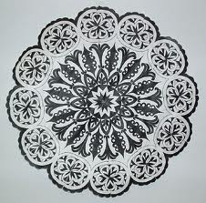
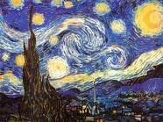
Balance
Think : ‘symmetry’

Slide 23
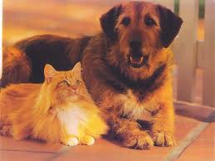
Contrast
Think ‘differences’

Slide 24
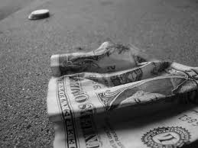
Emphasis
Think ‘focal point’

Slide 25
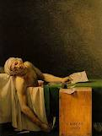
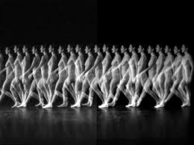
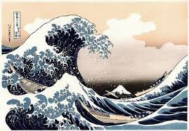
Movement
Think ‘how eyes move around the art’

Slide 26
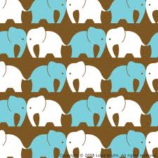
Pattern
Think ‘texture + rhythm’

Slide 27
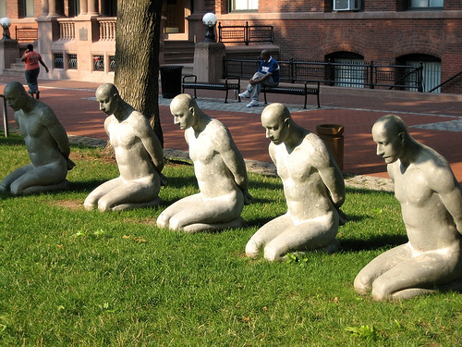
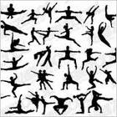
Rhythm
Think ‘repetition of elements’

Slide 28
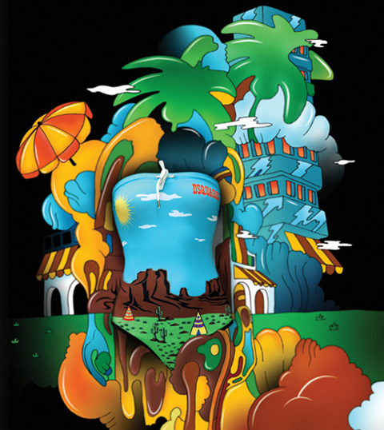
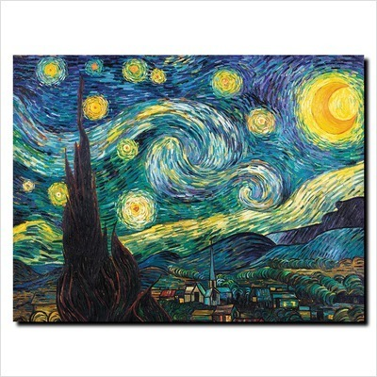
Unity
Think ‘harmony’ (or what holds it all together)

Slide 29
PRINCIPLES
balance
contrast
emphasis
movement
pattern
rhythm
unity
ELEMENTS
line
shape
color
value
form
texture
space

