Slide 1
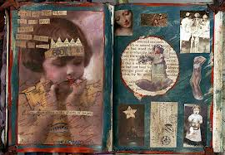
Altered Books
Transform the ordinary into the extraordinary

Slide 2
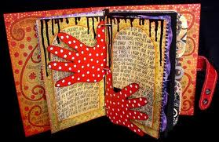
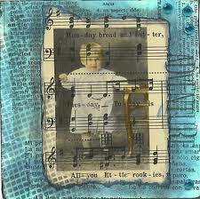
‘Page 1’ – Hands & Tape Transfer

Slide 3
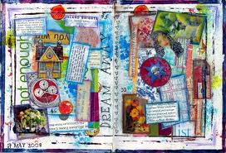
‘Page 2’ - Collage

Slide 4
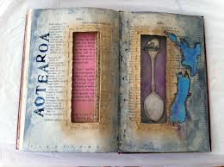
‘Page 3’ – Cut-outs

Slide 5
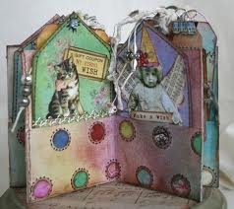
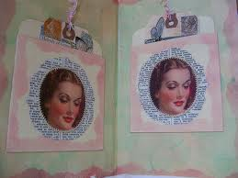
‘Page 4’ - Pockets

Slide 6
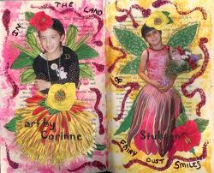
Themes
Use one of the traits of character (tolerance, commitment, responsibility, perseverance, respect, innocence, etc)
Explore a social issue such as poverty, homelessness, free speech, love, etc.
Tell a story that you create

Slide 7
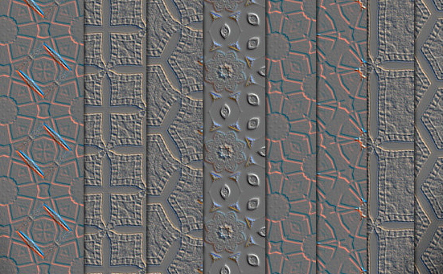
Day One Goals
Create textured & painted papers for use in your book
Think about your theme as you work today
Have your theme chosen by tomorrow!!

